Slide 1

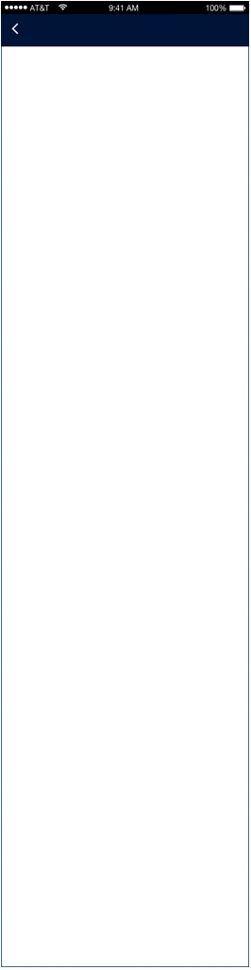



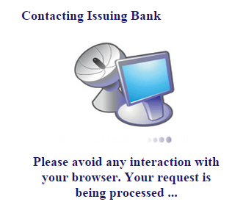




Add Credit Summary
Payment
MasterCard Secure Code
Authenticate
Payment Amount IDR 10.000.000
Secure Payment Page
To complete your payment, please provide your payment information. Payment information provided will be encrypted before being sent over the internet. This is to keep the information from being stolen or intercepted while it is being transmitted to the bank.
Payment Method
Credit Card
Enter Your Security Code
Please verify your online payment by entering the security code that we have just sent to you via SMS. This information is not shared with the merchant.
Processing Fee IDR 300.000
Total Payment Amount IDR 10.300.000
Your Transaction Information:
Merchant Name
Numoni
Please confirm that you understand
and accept our Terms & Conditions.
Merchant Name
Numoni
Amount
IDR 10,300,000
Date
30-Jul-2016
Merchant Transaction ID
12345678FUEGD
Card Number
XXXX XXXX XXXX 6789
PAY
Amount
IDR 10,300,000
Message
We have sent your security code to the mobile number ending in XXX, that is registered on this account.
Processing Fees
The processing fee is chargeable per payment transaction when payment is made ONLINE through credit card, debit card or charge card only. This fee covers the cost of processing the payment transaction.
Transaction Description:
P2P MARKETPLACE ADD CREDIT
We comply with all applicable privacy laws. All information collection on our web pages will remain private and confidential. Please note that by submitting your personal information to us, you consent to our privacy statement that governs your account.
Security Code
Didn't receive a security code?
Enter Your Payment Information:
Submit
Cancel
Name On Card **
Exit
Please enter name as stated on credit/debit card
Credit/Debit Card Number **
Verified By Visa
Payment Successful
Transaction Notification
Please do not include space or dash between the credit/debit card numbers
Card Type **
Thank You!
Your Transaction was Successful.
_________________________________________
Please wait… whilst we finish processing your payment.
If you are not automatically re-direction in 10 seconds, please click here.
Merchant ID
xxxxxxxxxx
Visa
Added Protection
Please submit your Verified by Visa password.
Numoni Txn Ref
xxxxxx
Card Expiry Date **
Transaction ID
477CD14300F6000D01FD
- -
- -
Merchant Name
Numoni
Transaction Date
2016-07-30 12:35:49
Card CVV/CV2 **
Amount
IDR 10,300,000
Amount
IDR 10,300,000
Date
30/07/2016
Transaction Status
Approved
Cancel
Submit
Card Number
XXXX XXXX XXXX 0335
Auth Code
xxxxx
Personal Message
Shop securely with Verified by Visa.
Note:
Upon clicking on Submit, you will be redirected to the bank system. Please do not refresh or closed your browser until your transaction has completed.
This page requires Internet Explorer 6.0 above or compatible browser.
Pop-up killers should also be disabled before you proceed.
Please ensure that cookies and Javascript is enabled on your browser.
Password
Forgot your password?
Submit
Help
Help

Slide 2
Payment
My Loans Portfolio
Transaction Notification
Transaction History
Merchant ID
xxxxxxxxxx
Country
Select Country
Country
Select Country
Numoni Txn Ref
xxxxxx
View Transaction
Select Txn Period...
View Portfolio
Select Portfolio Return
Transaction ID
477CD14300F6000D01FD
Last 1 Month
Last 20 Transactions
Last 6 Months
Last 1 Year
Transaction Date
2016-07-30 12:35:49
Amount
IDR 10,300,000
Last 20 Transaction History
Portfolio Return over Last 6 Months
Transaction Status
Approved
Txn Date
Txn Type
Amount
Loan ID
Invested Date
Disbursement Date
Maturity Date
Tenure
Investment Amount
Net Return
Investment Return
Repayment Status
Auth Code
xxxxx
30-07-2016
Add Credit
IDR 10,000,000
IDR1,000,000
IDR1,300,000
Amount
%
Pending Repayment
Current Balance
IDR 10,000,000
XXXXXXXXXXX
15-07-2016
19-07-2016
18-08-2016
30 Days
IDR3,000,000
IDR300,000
30%
Paid
Txn Date
Txn Type
Amount
XXXXXXXXXXX
02-08-2016
06-08-2016
26-08-2016
20 Days
IDR3,300,000
IDR300,000
10%
Paid
02-08-2016
Investment
-IDR 3,000,000
XXXXXXXXXXX
13-08-2016
17-08-2016
27-08-2016
10 Days
IDR1,000,000
IDR1,100,000
IDR100,000
10%
Current Balance
IDR 7,000,000
Scroll to right to view more
Txn Date
Txn Type
Amount
13-08-2016
Investment
-IDR 1,000,000
Total Investment Amount (as of 27-08-2016)
IDR5,000,000
Current Balance
IDR 6,000,000
Total Investment Return
IDR4,000,000
Txn Date
Txn Type
Amount
Total Investment Return
IDR400,000
26-08-2016
Capital Return
IDR 3,000,000
Total Investment Return
Current Balance
IDR 9,000,000
Txn Date
Txn Type
Amount
26-08-2016
Interest Gain
IDR 300,000
Current Balance
IDR 9,300,000
Txn Date
Txn Type
Amount
27-08-2016
Capital Return
IDR 1,000,000
Current Balance
IDR 9,000,000
Payment Unsuccessful
Connection Timeout Error
Sorry!
Your transaction payment was declined by your card issuer.
_________________________________________
Please use a different payment card or contact your Issuing Bank for additional information.
Timeout Error!
We’re sorry, we are experiencing a system connection error. The site could be temporarily unavailable or too busy.
Please try again in a few minutes.
_________________________________________
Please contact our Helpline at xxxxxxxxxx, if problem persists!

